Slide 1
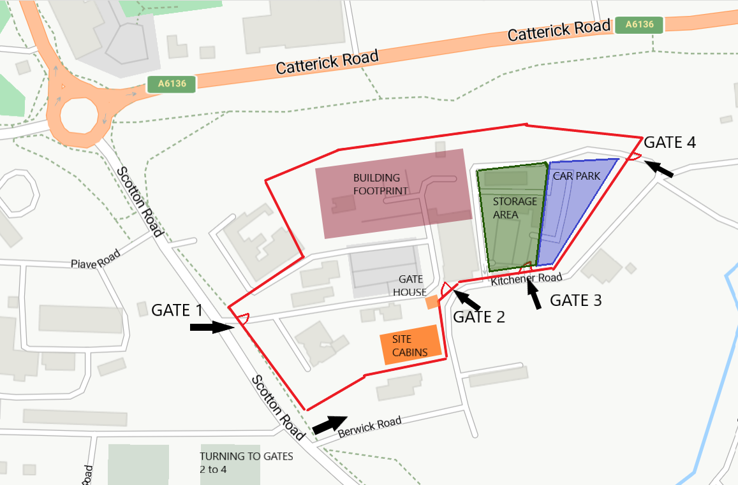
Tilbury Douglas – CICC Catterick
Drop-in Sessions
Parking for drop- in sessions

