Slide 1
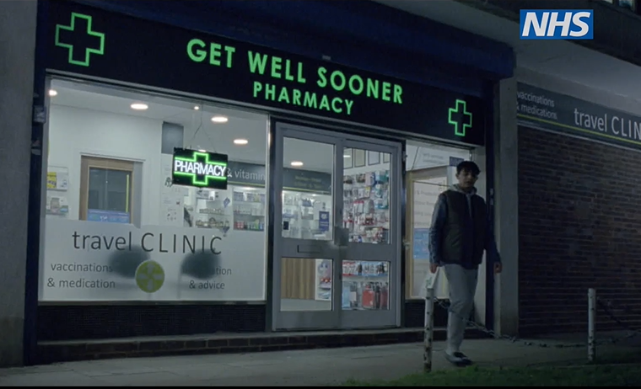
NHS 'Help Us, Help You' - Pharmacy Campaign
CAMPAIGN TOOLKIT
Launch: 11th November 2024

Slide 2
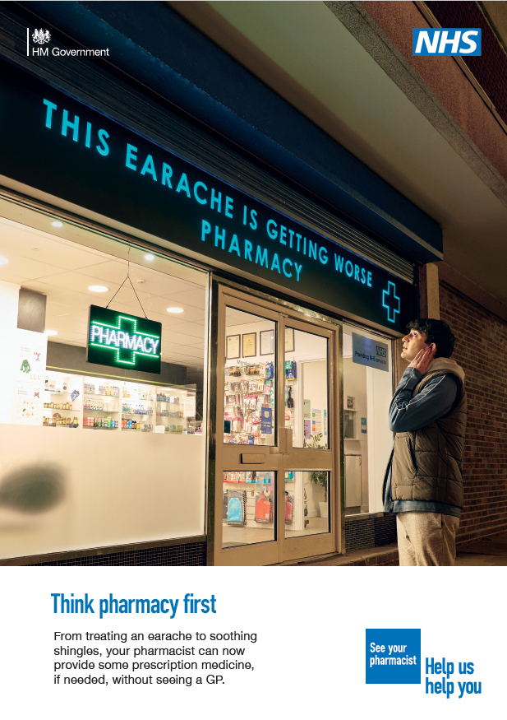
Campaign Overview
The community pharmacy-focused phase of NHS England's 'Help Us, Help You' campaign will launch from 11 November 2024. This is an expansion of the initial phase that ran in February/March 2024
The campaign will increase the public's awareness of the breadth of support community pharmacists can offer to patients on their doorstep. This will include highlighting the Pharmacy First service that allows pharmacists to offer treatment and provide some prescription medicine, if needed for the following conditions:
Sinusitis (for those aged 12 years and over)
Sore throat (for those aged 5 years and over)
Earache (for those aged between 1 and 17 years old)
Infected insect bite (for those aged 1 year and over)
Impetigo (for those aged 1 year and over)
Shingles (for those aged over 18 years old
Uncomplicated urinary tract infections (UTIs) (for women aged 16-64)
It will also promote the ability to initiate or provide ongoing supply of oral contraception (the creative for which is awaiting Clinical approval)
The campaign will seek to demonstrate how the health service is making it more convenient for people to access care. It will primarily target working age adults (18-40) who may experience minor health conditions. It will also reach ethnic minority groups and those with disabilities, to ensure it is addressing key health inequalities.
The campaign will run across England, with adverts on TV on Demand, on radio, in public spaces such as bus shelters, as well as adverts on relevant websites and search engines, online videos and social media, supported by PR and partnership activity until the end of December 2024.
This will be supported with activity targeted to multicultural audiences and engagement with charities and organisations that reach disabled audiences, including people with a learning disability. This activity will disseminate alternative formats, including British Sign Language (BSL) and Easy Read versions.
Notes:
This service will enable pharmacists to supply prescription-only medicines, including antibiotics and antivirals where clinically appropriate, to treat seven common health conditions (sinusitis, sore throat, earache, infected insect bite, impetigo, shingles, and uncomplicated urinary tract infections in women) without the need to visit a GP.

Slide 3
Paid Media Laydown
Channel | Media Channel | Team/Partner | Start Date | End Date
Video | Digital Video - VOD | AV | 11/11/2024 | 22/12/2024
Video | Digital Video - OLV | Direct Display | 11/11/2024 | 22/12/2024
Video | Digital TV | Programmatic | 11/11/2024 | 22/12/2024
Paid Social | Social | Social | 11/11/2024 | 22/12/2024
Radio | Radio | AV | 11/11/2024 | 15/12/2024
Audio | Digital Audio | AV | 11/11/2024 | 22/12/2024
OOH | OOH | Client Team | 11/11/2024 | 22/12/2024
Paid Search | Paid Search | Search | 11/11/2024 | 22/12/2024
Video | Digital Video - OLV | Community Media | 11/11/2024 | 22/12/2024
Radio | Radio | Community Media | 11/11/2024 | 22/12/2024
 | 0 | 0 | 00/01/1900 | 00/01/1900

Slide 4
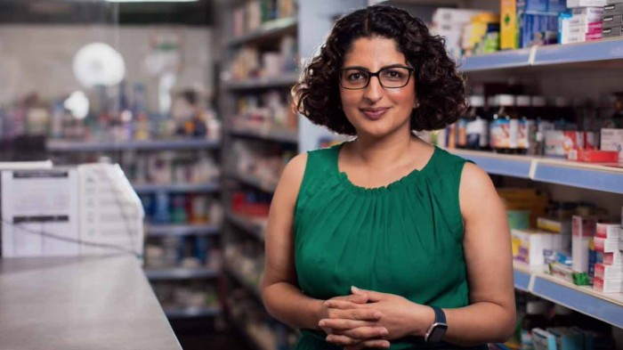
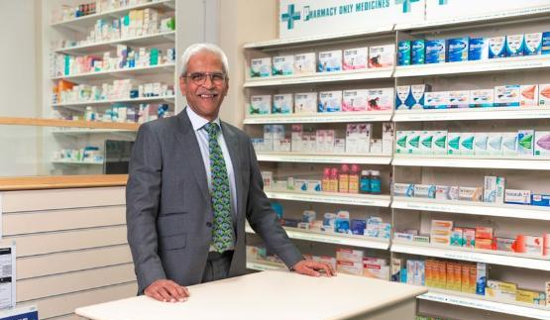
PR Activity and Targeting Multicultural Communities
Ongoing PR activity will see regular features placed with patient and pharmacist case studies across national and local media. There will also be a pre-recorded audio package highlighting key messages that will be played out across commercial radio stations in bursts throughout the campaign.
A multicultural strand of the campaign will reach Black and South Asian audiences, to acknowledge and address cultural nuances through appropriate messaging and channels.
This campaign will focus on Trusted Voices – community pharmacists from the two target audience backgrounds, who have connections to grassroots communities and can share campaign messages in their own authentic voice to drive relevance.
This campaign will launch national broadcast packages, working with key multicultural media across the UK. Presenter-hosted segments will include caller questions, live reads, guests and social media support to build understanding of the new elements of the pharmacist role. In addition, medi-influencers - South Asian and Black community pharmacists with an active social media presence - will co-create content and conversations that can be amplified to a wider audience.

Slide 5
Campaign Support
This toolkit includes campaign messages, long and short copy and links to suggested social media posts to help you support the national campaign and PR activity.
NHS HUHY pharmacy campaign resources can be downloaded, free of charge, from the Campaign Resource Centre from 8 November.
You can support the campaign by:
1
Downloading the campaign resources and sharing these with your colleagues, including local community pharmacies offering the new service, general practice, local communications networks and community organisations.
2
Sharing our campaign messages on social media, websites, email, and staff intranets to reach as wide an audience as possible
≈
3
Identify community pharmacy case studies in your region for potential involvement in media activities and to support the campaign locally.
If you have any queries about the campaign, please contact the NHS England Campaigns Team: england.campaigns@nhs.net​

Slide 6
Key Messages
Core messaging ​
Going to your local pharmacy offers an easy and convenient way to get clinical advice on minor health concerns - you don't need an appointment and you can be seen in a private consultation room.
Your local pharmacist can now offer treatment and provide some prescription medicine for seven conditions, if appropriate, without the need for a GP appointment or prescription.
These conditions include earache (for those aged between 1 and 17), impetigo (for those 1 year and over), infected insect bites (for those 1 year and over), shingles ( for those over 18 years old), sinusitis (for those aged 12 years and over), sore throat (for those aged 5 years and over) and urinary tract infections (UTIs) (for women aged 16-64 years).​
Pharmacists have the right clinical training to make sure you get the help you need and can also signpost you to your general practice team, A&E or other relevant local service, where necessary.
Wider messaging​
Community pharmacies are staffed by highly-skilled and qualified health professionals who are trusted parts of local communities:​
All pharmacists train for five years in the use of medicines before they qualify and are also trained in clinically assessing and treating minor illnesses and giving health and wellbeing advice to help people stay well.
Pharmacy technicians are part of the pharmacy team and are also registered health professionals.
The new expanded community pharmacy services which also include initiating oral contraception without needing to see a GP first, and providing more blood pressure check services, are are part of the NHS’ plans to recover and improve access to primary care services. It aims to free up to 10 million GP appointments a year once fully implemented, making it quicker and easier for the public to access healthcare in their local community, and giving them more choice in where and how they access care.
Over 10,200 pharmacies (95%+) have opted to deliver the service and 80% of people live within 20 minutes of a community pharmacy, making it a convenient and quicker way of accessing care.
Call to Action
Don't wait for minor health concerns to get worse – think pharmacy first and get seen by your local community pharmacy team.
For more information, visit nhs.uk/thinkpharmacyfirst
Notes:
This service will enable pharmacists to supply prescription-only medicines, including antibiotics and antivirals where clinically appropriate, to treat seven common health conditions (sinusitis, sore throat, earache, infected insect bite, impetigo, shingles, and uncomplicated urinary tract infections in women) without the need to visit a GP.

Slide 7
Content (1)
Below are some examples of long and short copy that could be used when communicating with audiences about the campaign. Please use the copy for any newsletters, emails or other materials, including websites, e-bulletins and social media. Statistics to localise the copy is shown in the ‘supporting data’ section.
LONG COPY
Going to your local pharmacy offers an easy and convenient way to get clinical advice on minor health concerns, and now community pharmacies can offer treatment and, when appropriate, some prescription medicine, for seven common conditions without patients needing to see a GP, as part of a major transformation in the way the NHS delivers care.
Highly trained pharmacists at more than nine in ten pharmacies can now assess, treat, and when appropriate, provide some prescription medicine for earache (for those aged between 1 and 17), impetigo (for those aged 1 year and over), infected insect bites (for those aged 1 year and over), shingles (for those aged over 18 years old), sinusitis (for those aged 12 years and over), sore throat (for those aged 5 years and over) and urinary tract infections (UTIs) (for women aged 16-64 years) without the need for a GP appointment.​
Community pharmacy teams are highly-skilled, qualified health professionals who have the right clinical training to give people the health advice they need. Patients don't need an appointment and private consultation rooms are available. Pharmacy teams can also signpost to other relevant local services where necessary.
Pharmacists have always helped patients, families and carers in their communities stay healthy and are well placed to offer treatment for health conditions. By expanding the services community pharmacies offer, the NHS is aiming to free up GP appointments and give people more choice in how and where they access care.
Don't wait for minor health concerns to get worse – think pharmacy first and get seen by your local pharmacy team.
For more information, visit nhs.uk/thinkpharmacyfirst

Slide 8
Content (2)
SHORT COPY
Community pharmacies can offer treatment and when appropriate some prescription medicine, for seven common conditions without patients needing to see a GP, as part of a major transformation in the way the NHS delivers care.
Highly trained pharmacists at more than nine in ten pharmacies can now assess, treat, and when appropriate, provide some prescription medicine for earache (for those aged between 1 and 17), impetigo, infected insect bites, shingles, sinusitis, sore throat, urinary tract infections (UTIs) for women aged 16-64 - without the need for a GP appointment.
Available at the heart of local communities, community pharmacy teams have the right clinical training to give people the health advice they need, with no appointment necessary and private consultations available. Community pharmacists will signpost patients to other local services where necessary.
By expanding the services community pharmacies offer, the NHS is aiming to help free up GP appointments and give people more choice in how and where they access care.
Don't wait for minor health concerns to get worse – think pharmacy first and get seen by your local pharmacy team.
For more information, visit nhs.uk/thinkpharmacyfirst

Slide 9
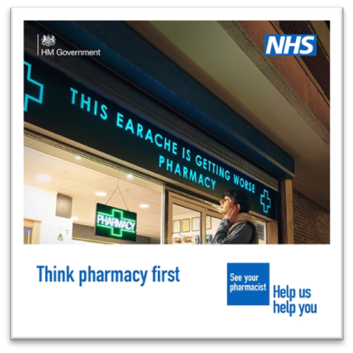
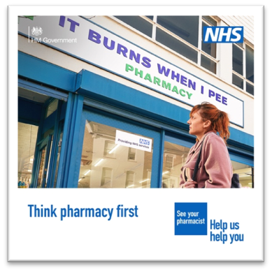
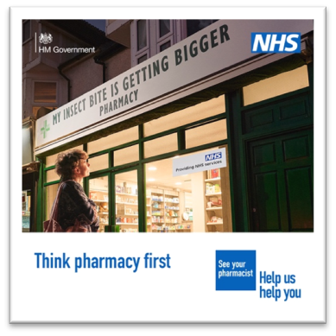
Social media
We will amplify the reach of the campaign by posting content across NHS media channels including X (formerly known as Twitter), Facebook and Instagram, Snapchat, Reddit, and Nextdoor.
Please help us get the message out there by using your social media channels to support the campaign.
Social media assets (videos and static images, some examples below) along with recommended accompanying post copy is available on the Campaign Resource Centre [Social media | Think Pharmacy First | Campaign Resource Centre (dhsc.gov.uk)]

Slide 10
Useful data - National
Public perceptions of community pharmacy
Nine in 10 (90%) pharmacy users in England perceive the quality of advice they received as good, while a similar figure (87%) reported being able to get what they needed.
Nearly eight in 10 (78%) pharmacy users in England said they were dealt with in a timely manner and a similar figure (77%) said they were given enough time to speak with someone at the pharmacy.
The public identify pharmacies as the organisation they would be most likely to go to if they needed information and advice on medicine (73%) or if they needed information or advice about a minor health condition (58%).
Public behaviours in relation to community pharmacy
Just over one-quarter (29%) of people in England say they contact or visit a community pharmacy, either for themselves or someone they care for, at least monthly, while one in five (20%) say they do not normally contact or visit a community pharmacy.
More than four in ten (42%) people in England would not go to a pharmacy to get information and advice on minor conditions, while more than a third of people (34%) in England do not know that pharmacies can provide advice about medicines and nearly a quarter (22%) do not know pharmacies provide prescription medicines.
Source: Ipsos. Public perceptions of community pharmacy 2023

Slide 11
Evaluation - Measurement
NHS campaign activity is evaluated in line with the Government Communications Service (GCS) Evaluation Framework 2.0.
It is important that we monitor and evaluate all our campaign activities effectively to show how campaigns contribute towards successful policy outcomes, providing clear evidence of impact and value for money.
The GCS Evaluation Framework 2.0 provides a structure for a monitoring and evaluation plan including outputs, out-takes, outcomes and organisational impact that you can apply to your local activity.
It recommends standard evaluation measures that you can use to:
develop SMART (Specific, Measurable, Attainable, Relevant, Time-bound) communication objectives and Key Performance Indicators (KPIs)
use evaluation to improve the effectiveness of all communication and campaign activity
More information can be found via:
Monitoring and evaluating government communications activity - GCS (civilservice.gov.uk)

