Slide 1
Humber and North Yorkshire Health Equity Fellowship 2025-26
Information pack

Slide 2
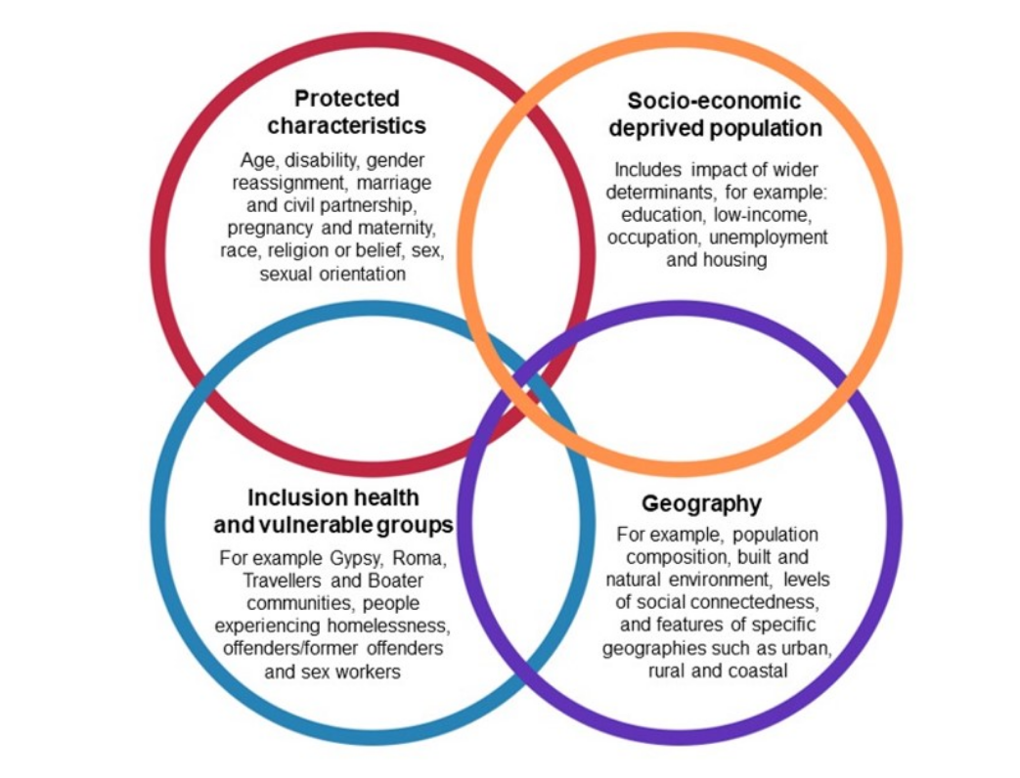
Background
What are the 4 purposes of the ICS?
Improving outcomes in population health and healthcare;
• Tackling inequalities in outcomes, experience and access;
• Enhancing productivity and value for money;
Supporting broader social and economic development.

Slide 3
Introduction to Health Equity Fellowship Programme
We are very pleased to launch recruitment into the 25/26 Humber and North Yorkshire Health Equity Fellowship Programme. We are looking for 50 enthusiastic people who want to make a change and tackle inequalities in Humber and North Yorkshire.
This Programme aims to give Fellows the skills they need to improve population health and reduce health inequalities in their own organisation and across the Humber and North Yorkshire area. It is modelled on and supported by a well-recognised programme in West Yorkshire.
The following information pack will provide organisations, employers and our workforce with information about the:
Fellowship Programme
Benefits of being a fellow
Benefits for organisations releasing people for the fellowship
How to apply
FAQs and more

Slide 4
Timeline
Event | Date
Information pack available | 7 November 2024
Applications open | 13 November 2024
Event: first virtual information event | 27 November 24
Event: second virtual information event | 11 December 24
Applications close | 24 January 2025 Extended to 14th Feb
Recruitment Panel | 27-30 January 2025
Notify applicants of outcome | February 2025
Fellowship start date | April 2025

Slide 5
Fellowship Expectations
The Humber and North Yorkshire Health Equity Fellowship will run between April 2025 and March 2026.
Fellows will be expected to dedicate one day a week of their time to attend training and work on a fellowship project.
Projects will be bespoke to the fellowship theme (Health Equity) and criteria. A list of potential projects will be provided for inspiration, though creativity is encouraged.
Projects can be delivered in the applicant’s usual place of work or contribute to wider joined up approaches taking place across the area. Submission of an interim and final report is required as part of the programme.
Meetings and training may be face to face at a central location or virtually. Fellows are expected to attend all meetings and training and therefore must be able to travel. They will require a device and an internet connection.

Slide 6
Benefits for Organisations
Fellowships will:
Provide the opportunity to change behaviour, empower employees, and build authentic relationships with networks and partners across Humber and North Yorkshire.
Support professional and personal development, with no cost to the fellows organisation/employer.
Meet the shifting needs of employees, organisations and communities/populations they serve.
Give employees the confidence, insights, and motivation to expand or extend their work.
Fellows will:
Gain valuable exposure and experience while learning under the guidance of mentors and experts.
Receive guidance, institutional support, and professional development to the fellow.
Gain practical knowledge through experiential learning.
Be a champion within the organisation to support improving population health and reducing health inequalities.
Fellows will bring back to the organisations:
New ideas, tactics, and perspectives.
Empowerment to participate in social responsibility and community engagement.
Contribution to the future success of the organisation in a given field.

Slide 7
Benefits of Being a Fellow
Enhance knowledge, skills, and capability by delivering a fellowship project relating to health inequalities.
Mentor support throughout your fellowship journey e.g., embedding learning and developing relationships across Humber and North Yorkshire.
Free Foundation Programme in Public Health training delivered by Barnsley Council and NHSE. This training is accredited by Royal Society of Public Health.
Bespoke training in your chosen area with access to materials and educational opportunities.
Expand your professional networks through engagement with other fellows.
Build relationships and network with different organisations across Humber and North Yorkshire.
Exposure to experts, programmes and organisations pioneering positive change.
Publication of fellowship projects on our website and partner websites.

Slide 8
Health Equity Fellows
Programme objectives
Identify and respond to health inequity and inequalities Build equity and inequalities champions across Humber and North Yorkshire Create a health equity fellow peer Network Share learning and best practice across Humber and North Yorkshire
Health Equity Fellows will be working towards the ambition to equip all staff with an understanding of the individual and collective action we can take to create a more equitable health and care system.
We have set strategic ambitions to reduce health inequalities. The need for these ambitions has been reinforced by health inequalities made worse by the COVID-19 pandemic and the recent cost of living challenges faced by our population.
Addressing health inequalities requires a whole system approach from strategic planning and leadership to community level service delivery. This fellowship programme seeks to develop colleagues across Humber and North Yorkshire who understand the foundations of health inequity and have the knowledge, skills, and courage to build more equitable organisations and communities.

Slide 9
Foundation Programme in Public Health
The Foundation Programme in Public Health, is a training suite, designed by the Yorkshire and Humber School of Public Health. Its purpose is to help health and social care colleagues improve their knowledge and understanding of health inequalities to better support population health initiatives. The programme is split into level 1 and level 2. Both levels consist of four, three-hour training session. Level 1 is mandatory as part of the Fellowship; level 2 is optional.
Benefits of the programme include:
foundation level knowledge and understanding of health inequalities
improved understanding of how current specialisms can be reoriented to address health inequalities
improved understanding of how emerging population health policies can address health inequalities
improved understanding of how system-wide working can address health inequalities
improvement in the overall number, quality and impact of health promotion, protection, or prevention initiatives.
See the website pages for more information about the programme.

Slide 10
Who Should Apply?
The Health Equity Fellowship is designed to bring together the diverse organisations and professionals that influence health and wellbeing, attracting applicants that are representative of the communities we serve.
They are open to all colleagues from all sectors, health, social care, local authority and the voluntary and community sector across the Humber and North Yorkshire irrespective of your current job role, grade or profession. There are no specific educational requirements.
To apply you must:
Be passionate about reducing health inequalities
Want to become a champion and achieve change
Be committed to the delivery of a fellowship project
Agree to carry out formal learning as part of the fellowship
Confirm prior support from your current organisation that you will have protected time to take part fully in the fellowship

Slide 11
How to Apply?
Applications open on 13th November 2024. Send your completed application to hnyicb-ery.populationhealthandprevention@nhs.net.
In your statement of interest, you will need to include:
personal information (name, contact details, current role and organisation, location and ethnicity)
Brief information about you and your personal motivation for applying
the inequalities challenges you see in your current role and how you would seek to expand your learning and experience to address these through the fellowship
relevant work, voluntary and community experience and contributions, and how this will support you in your fellowship
how you plan to continue to develop your knowledge and skills after completing the fellowship
initial idea for a fellowship project
confirmation of support from your employing organisation and your line manager
The Health Equity Fellowship - Humber and North Yorkshire Health and Care Partnership have everything you need to apply including a Statement of Interest form and accessible information pack. For accessible formats of the Statement of Interest form please contact us on hnyicb-ery.populationhealthandprevention@nhs.net.

Slide 12
Selection Criteria and Process
The fellowship will develop and support fellows from across the Humber and North Yorkshire. It will equip you with the knowledge, skills, mentors, and networks to advance capability, capacity and intelligence in your chosen area, across your organisations and communities.
During the selection process we will consider:
Demonstration of commitment and passion in improving population health and reducing health inequalities.
How you will help improve outcomes for people who live and work in in Humber and North Yorkshire.
Selection panels for each area will score applications against the following criteria:
Strength of statement of interest, including your personal motivation and commitment to chosen fellowship speciality.
How you will continue to apply learning following the fellowship in your workplace or community.
Quality of your proposed fellowship project.
Confirmation of support from your line manager.
We will also seek to recruit fellows that reflect a variety of professional backgrounds and are representative of the communities we serve.

Slide 13
Frequently Asked Questions (FAQs)

Slide 14
FAQs: Accessibility
Will the fellowships provide adjustments and accessible information?
Yes, all materials are also available in accessible format.
It is legally required that we produce accessible versions of all information and publications. If you apply and need additional support, then we will make sure we can do what we can to meet your needs.
The training providers are also committed to accommodating any accessibility requirements and specific needs that you have. We will discuss this in advance, so we understand what is required.
Please contact: hnyicb-ery.populationhealthandprevention@nhs.net if you have any queries regarding this.

Slide 15
FAQs: Funding
Does the programme provide funding for backfill?
Not for statutory organisations. Funding may be available to support applications from the voluntary community social enterprise sector to backfill time for successful applicants.
Who would fund any required project costs?
Additional funding is not currently available to cover fellowship projects. When agreeing projects, we will take resource into consideration and where this may come from.
Many projects will have to be cost neutral or reinvestment projects or will need to have the caveat that we, you know, this might be something we need to do or should be done, but we need to find the resource to go with it.
Are the costs to cover the fellowship day per week paid for by the scheme or the department/organisation the fellow has come from?
All salary costs would come from the employing organisation. As a result, all applicants will need to agree this in advance with your employing organisation and line manager.
What are the costs associated with the fellowship?
There is no cost required to be a fellow or for any of the support and training provided. The costs for your organisation will be related to releasing you for one day a week to undertake the programme, project, and training. We do encourage fellows to link their fellowship to their areas of work, this potentially would mean all stakeholders benefit from the fellowship. Travel to and from meetings is at the fellow’s expense.

Slide 16
FAQs: Dedicated one Day per Week
How much time will the fellowship take?
The fellowship will run for 12 months. You will need to spend one day a week on fellowship training and on delivering a fellowship project.
Is it confirmed what day fellows need to take and does it have to be on a day I would be employed on by my employer?
Days will on the whole be flexible. For dates that are set, we’ll give you notice in advance. It does not have to be an employed day.
What constitutes one day a week?
7.5 hours is a working day.
How many cohorts are you planning?
This is the first cohort of the Health Equity Fellowship in Humber and North Yorkshire. We are building on the success of the fellowship in the West Yorkshire Health and Care Partnership, launching our own programme using this learning. We hope to have more cohorts going forwards.
How will you incorporate people working part time?
There is an expectation for all fellows to undertake a fellowship project as part of the programme, regardless of whether you work full or part time. However, if you have any specific requirements, we will discuss these with you and how that fits in with your working day.

Slide 17
FAQs: Your Project
What is the project population focus?
Projects can focus on any population you choose or work with. We are happy to help successful applicants work through projects. Applicants are welcome to test out any project ideas with us.
Will you publish and share learning and information from projects?
Yes, we will publish projects on our websites and evaluate the fellowship.
Should projects be at organisational level or departmental level?
Projects can focus on any level/part of an organisation.
Do I have a say in which project to take part in?
Yes, you will be asked for your project ideas in your application. We will support you to refine and develop your project once selected to the scheme.
Would there be a possibility to publish projects e.g., as a journal article if my employer is willing to pay the costs?
Yes. Projects will also be published on the Humber and North Yorkshire Health Equality fellowship page and may also form part of case study evaluations and short films.
How often will I meet with my mentor?
We would expect you meet once a month, but you can meet more frequently if you both choose.
Will there be any report writing in the project?
As part of your fellowship project, we expect fellows to complete an interim report halfway through the fellowship and a final report at the end. Your mentor will assist you with these reports, provide feedback and we will provide guidelines. There is flexibility if a written report is not for you.

Slide 18
FAQs: Fellowship Training
What’s in Public Health course work look like?
It is compulsory for fellows to take part in the level 1 Foundation in Public Health course which covers key topics and ideas. This training will help with the development of fellowship projects. There are four, three hours training sessions in total; covering a range of public health skills. Training sessions will include teaching, but you will also be expected to participate in group work as well in every session.
Participants who attend all four public health training sessions, will receive a certificate from the f, which highlights learning outcomes from all sessions, plus CPD credits that you can use in personal development plans or equivalent plans in due course.
Will there be any other training outside of the Foundation Programme sessions?
Yes, we welcome requests for any other training you think might help with your project and learning.
All fellows will also have the option of attending trauma-informed training from Dr Warren Larkin as part of the fellowship programme.

Slide 19
For more Information...
For general enquiries about the programme, Foundation Programme, interim and final report submissions:
iphp.fellowshipenquiries@nhs.net
Please copy hnyicb-ery.populationhealthandprevention@nhs.net
in all communications.
Specific enquiries, e.g. feedback, mentoring and further support:
hnyicb-ery.populationhealthandprevention@nhs.net
For examples of completed projects and testimonies from alumni of a similar programme in West Yorkshire, please see:
Health Equity Fellowship 2022 :: West Yorkshire Health & Care Partnership (wypartnership.co.uk)

