Slide 1
Humber and North Yorkshire 2024 Asthma Guidelines
The enclosed asthma guidelines are intended for use by clinicians working in Humber and North Yorkshire. These guidelines have been developed to inform treatment decisions for:
People with suspected asthma that are awaiting objective diagnostic testing
People with newly diagnosed asthma
People with uncontrolled asthma considered by their clinician to require a change in treatment
People considered by their clinician to require a change in asthma treatment for another reason through shared decision making
The green leaf symbol identifies the lower carbon footprint regimen and devices.
Inhaler choice should be based on an individual patient’s needs, choice and ability to use the device.
Controlled asthma has a significantly lower environmental impact than uncontrolled asthma.
These guidelines are not intended to and should not be used to support or justify a switch in asthma therapy that is not clinically indicated. All change in treatment should be made through shared decision making between a patient and their clinician.
Guideline Key
AIR: anti inflammatory reliever
ICS: inhaled corticosteroid
LABA: long-acting beta agonist
LAMA: long-acting muscarinic antagonist
LTRA: leukotriene receptor antagonist
MART: maintenance and reliever therapy
SABA: short-acting beta-agonist
HNY Adult Asthma Guidelines FINAL Approved by xxxxxxx

Slide 2
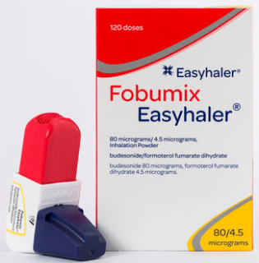
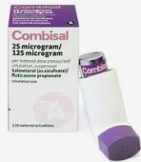
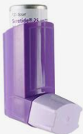
Suspected Asthma
Aged 5-11 years
HNY Asthma Guidelines FINAL Approved by IPMOC xxxxxxx
Confirmed Asthma in Children Aged 5 -11 Years Old
Before adjusting asthma medications, consider and address the reasons for uncontrolled asthma. These may include:
Alternative diagnoses or comorbidities.
Poor adherence to treatment.
Suboptimal inhaler technique.
Smoking or exposure to e-cigarettes (active or passive).
Psychosocial factors.
Seasonal influences.
Environmental triggers such as air pollution (indoor and outdoor).
Step-up and step-down treatment to achieve control with the lowest possible maintenance treatment
*Refer the child to a specialist in asthma care:
If asthma is not controlled on paediatric moderate-dose MART or Paediatric moderate dose ICS/LABA maintenance treatment
2 or more courses of oral steroids in the previous 12 months
2 or more attendances to ED in the previous 12 months
Following inpatient/acute admission to hospital
Diagnostic uncertainty
Referral to TERTIARY Care if patient has required PICU admission for asthma.
Continue Paediatric low dose ICS + SABA
Consider adding
LTRA (OD)
For a trial period of 8-12 weeks.
Stop if ineffective or side effects
Consider increasing to Paediatric moderate-dose ICS/LABA + SABA
(Continue LTRA if effective)
Consider switching to Paediatric low-dose ICS/LABA + SABA
(Continue LTRA if effective)
Arrange diagnostic testing in accordance with Guidelines.
Trial of Treatment
Paediatric low dose ICS
+
SABA reliever
as needed
for relief of symptoms
Review response to treatment at 8 weeks
If good response and/or asthma diagnosis confirmed
Continue
Consider switching to
Paediatric Low dose
Maintenance and Reliever Therapy (MART)
Regular ICS/Formoterol AND as required for relief of symptoms.
*Refer the child to a specialist in asthma care
Consider switching to
Paediatric Moderate-dose MART
Licensed treatment options (traditional track)
6months - 5years
Montelukast 4mg OD at night
6 - 11years
Montelukast 5mg OD at night
Discuss Potential side effects prior to prescribing
Clenil® 100 pMDI
One puff BD via a spacer
Soprobec 100 pMDI
One puff BD via a spacer
Flixotide® 50 pMDI
One puff BD or Two puffs OD via a spacer
Combisal 50/25 (pMDI)
Two puffs BD
via a spacer
Seretide 50 (pMDI)
Two puffs BD via a spacer
Fobumix 80/4.5 DPI
One inhalation BD or Two OD
Symbicort 100/6 DPI One
inhalation BD or Two OD
Combisal 125/25 (pMDI)
One puff BD
via a spacer
Seretide 125 (pMDI)
One puff BD via a spacer
Fobumix 160/4.5 DPI One inhalation BD or Two OD
Symbicort 200/6 DPI One inhalation BD or Two OD
Consider MART Assess ability of child and carers to manage MART regimen & DPI
Symbicort 100/6
One inhalation BD or Two Inhalations OD
AND
One inhalation as required for symptom relief (Max 8 puffs/ day)
Symbicort 200/6
One inhalation BD or Two Inhalations OD
AND
One inhalation as required for symptom relief (Max 8 puffs/ day)
*Refer the child to a specialist in asthma care
Pulmicort 100, DPI, Two inhalations BD
Budesonide 100 Easyhaler (DPI)
Two inhalations BD
Spacers
SABA Relievers
Short-acting beta agonist (SABA) relievers are recommended in this age group, but should not be prescribed without concomitant inhaled corticosteroid in the management of chronic asthma
SABA-only treatment is associated with risk of asthma attacks and asthma deaths.
SABA over-use in asthma ($≥$3 canisters per year) is associated with increased risk of asthma attacks and asthma deaths.
Unless using MART, asthma patients should be prescribed inhaled corticosteroids alongside a SABA- reliever.
Aerochamber plus Flow-Vu Youth
(5-16 years)
Volumatic Spacer
Salamol 100
(pMDI)
1-2 puffs PRN
Via a spacer
Salamol 100 Easi-Breath (pMDI)
1-2 puffs PRN
Salbutamol Easyhaler (DPI)
1-2 puffs PRN
Notes:
Removed bricanyl
Added statement ‘unless using MART’, to SABA box
Removed statement re ‘off-label’ in MART box…. This is a recommended approach by BTS, NICE, SIGN guidelines so I don’t think we need to explicitly state that it is off-label here….

Slide 3
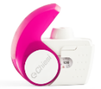
Before adjusting asthma medications, consider and address the reasons for uncontrolled asthma.
These may include:
Alternative diagnoses or comorbidities.
Poor adherence to treatment.
Suboptimal inhaler technique.
Smoking or exposure to e-cigarettes (active or passive).
Psychosocial factors.
Seasonal influences.
Environmental triggers such as air pollution (indoor and outdoor), occupational exposures.
Suspected Asthma
Confirmed Asthma in People Aged $≥$ 12 Years Old
HNY Asthma Guidelines FINAL Approved by IPMOC xxxxxxx
Step-up and step-down treatment to achieve control with the lowest possible maintenance treatment
Start here if:
- Asthma uncontrolled on high-dose ICS containing regimens
Start here if:
- Newly diagnosed asthma with daily symptoms, regular night-time symptoms or exacerbations OR
- Asthma uncontrolled on low-dose ICS containing regimens.
Start here if:
- Asthma uncontrolled on moderate-dose ICS containing regimens.
Start here if:
- Newly diagnosed asthma with symptoms less than daily and no night-time symptoms. OR
- Asthma and prescribed SABA-reliever only
Refer for specialist care
(see page 3)
If blood eos $≥$ 0.3x10⁹/L
or
FeNO $≥$ 50ppb (adults) or $≥$ 35ppb (aged 12-17)
Moderate dose
Maintenance and Reliever Therapy
(MART)
Regular ICS/Formoterol and as required for relief of symptoms
Arrange diagnostic testing in accordance with Guidelines.
Low dose
Maintenance and Reliever Therapy
(MART)
Regular ICS/Formoterol and as required for relief of symptoms.
As-needed
Anti-inflammatory Reliever
As-needed ICS/Formoterol
for relief of symptoms
If still uncontrolled on moderate dose MART measure
Blood Eosinophils
and FeNO
As-needed ICS/Formoterol
for relief of symptoms
(review after diagnostic testing)
If neither are elevated
(Refer 12-17 year olds for specialist care)
Beclomethasone-formoterol combination inhaler (e.g. Fostair and Luforbec) use in people aged 12-18 years would be off-label. Available data suggest an acceptable safety profile and use can be considered where budesonide-formoterol combinations are unsuitable.
Add
LTRA AND / OR LAMA
Licensed & recommended treatment options
Age 12-17 years
Age $≥$ 18 years
Only certain ICS-formoterol inhalers are licensed for use as ‘as-needed’ AIR, without additional maintenance doses. Use of other off-label ICS-formoterol inhalers (see MART sections) can be considered when licensed options are unsuitable.
Only certain ICS-formoterol inhalers are licensed for use as ‘as-needed’ AIR, without additional maintenance doses. Use of other off-label ICS-formoterol inhalers (see MART sections) can be considered when licensed options are unsuitable.
Beclomethasone-formoterol combination inhaler (e.g. Fostair and Luforbec) use in people aged 12-18 years would be off-label. Available data suggest an acceptable safety profile and use can be considered where budesonide-formoterol combinations are unsuitable.
Symbicort 200/6
1 inhalation
as required
Fobumix 160/4.5
1 inhalation as required
Symbicort 200/6
1 inhalation
as required
Fobumix 160/4.5
1 inhalation as required
Symbicort 200/6
1 inhalation BD
AND
1 inhalation as required
Fobumix 160/4.5
1 inhalation BD AND
1 inhalation as required
Symbicort 200/6
2 inhalationa BD
AND
1 inhalation as required
Fobumix 160/4.5
2 inhalations BD AND
1 inhalation as required
If remains uncontrolled after 8-12 week trial
Symbicort 200/6
1 inhalation
as required
Fobumix 160/4.5
1 inhalation as required
Symbicort 200/6
1 inhalation
as required
Fobumix 160/4.5
1 inhalation as required
Symbicort 200/6
1 inhalation BD
AND
1 inhalation as required
Fobumix 160/4.5
1 inhalation BD AND
1 inhalation as required
Fostair Nexthaler 100/6 1 inhalation BD AND
1 inhalation as required
Luforbec 100/6
1 inhalation BD
AND
1 inhalation as required
Symbicort 200/6
2 inhalationa BD
AND
1 inhalation as required
Fobumix 160/4.5
2 inhalations BD AND
1 inhalation as required
Fostair Nexthaler 100/6 2 inhalationa BD AND
1 inhalation as required
Luforbec 100/6
2 inhalations BD
AND
1 inhalation as required
Refer for specialist care
(see page 3)
Anti-inflammatory reliever (AIR) - based asthma treatment
As-needed AIR (without maintenance doses) or MART should be used for all asthma patients aged 12 years and older that are: i) newly diagnosed or ii) have known asthma and are uncontrolled on existing asthma treatment.
Short-acting beta agonists (SABA) are not recommended for the management of chronic asthma
SABA-only treatment is associated with risk of asthma attacks and asthma deaths.
SABA over-use in asthma ($≥$3 canisters per year) is associated with increased risk of asthma attacks and asthma deaths.
Asthma patients should be prescribed an anti-inflammatory reliever (as above) instead of a SABA-reliever.

Slide 4
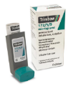
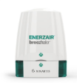
Suspected Severe Asthma (Aged $≥$12 years)
Severe asthma effects around 10% of all asthma patients and refers to people that either: i) require high-dose inhaled corticosteroids to achieve control, or ii) remain uncontrolled despite treatment with high-dose inhaled corticosteroids. Difficult asthma is different to severe asthma and refers to people with asthma who’s symptoms are uncontrolled due to factors other than asthma (e.g. poor adherence with treatment, breathing pattern disorder, reflux disease, inducible laryngeal obstruction, obesity, and/or breathing pattern disorder). People with both difficult and severe asthma should be referred for specialist care.
Who to refer for specialist review with suspected severe asthma
When to refer with suspected severe asthma
What information to include in the referral for suspected severe asthma
What to do while your patient is awaiting specialist review
People with suspected severe asthma should be referred for specialist assessment without delay. However, many patients with suspected severe asthma can be controlled with good quality standard asthma care. Therefore, the following should be considered prior to referral:
Asthma diagnosis should be reviewed & confirmed.
Assess and optimise adherence with regular preventer/controller medication.
Inhaler technique should be assessed and taught.
Triggers should be identified and, where possible, exposure removed.
Co-morbidities/difficult asthma features should be identified and treatment optimised.
Summary of current symptoms and concerns.
Details of past medical history to include co-morbidities, difficult asthma features and their treatment.
Current asthma treatments including dose and evidence of adherence.
Past asthma treatments and reason that they were discontinued (e.g. lack of effectiveness, adverse effects etc.)
Number of exacerbations in the past year (number of acute OCS courses).
Objective tests supporting asthma diagnosis (past and/or present).
T2 biomarkers: highest blood eosinophils within the past year and FeNO.
History of atopy, including results of allergy testing (e.g. IgE, Specific IgE (RAST), skin prick testing).
Consider seeking specialist advice through:
Advice and Guidance (include the same information as per referral)
Community MDT discussion (where available).
Asthma patients taking fixed, high-dose ICS-LABA combination inhalers +/- additional controllers and requiring 2 or more OCS courses within the past year
Consider the below options depending on existing treatment
Moderate Dose MART
Regular ICS/Formoterol and as required for relief of symptoms
Fixed, high-dose ICS-LABA + SABA reliever
Asthma patients taking moderate-dose MART and evidence of T2 inflammation (blood eos 0.3x10⁹/L or FeNO $≥$ 50ppb in adults or $≥$ 35ppb for those aged 12-17 years) and requiring 2 or more OCS courses within the past year
Adults Only
Moderate Dose MART
Plus trial LAMA
High-dose ICS/LABA/LAMA
Closed Triple (Adults Only)
Reliever
SABA as required for relief of symptoms
Symbicort 200/6
2 inhalations BD
AND
1 inhalation as required up to a maximum 12 inhalations daily
Fobumix 160/4.5
2 inhalations BD AND
1 inhalation as required up to a maximum 12 inhalations daily
Fostair Nexthaler 100/6 2 inhalations BD AND
1 inhalation as required up to a maximum 8 inhalations daily
Luforbec 100/6
2 inhalations BD
AND
1 inhalation as required up to a maximum 8 inhalations daily
Trimbow pMDI
Enerzair Breezhaler
Asthma patients taking moderate-dose MART without evidence of T2 inflammation + LTRA + LAMA and requiring 2 or more OCS courses within the past year
Spiriva Respimat
If requiring frequent reliever doses, exceeding maximum daily dose.
Trial additional controller therapies (if not already trialed)
LTRA AND/OR Methylxanthines* AND/OR Macrolides*
(*only after specialist advice - adults only)
Biologics in Severe Asthma
Biologics are advanced treatments that target specific inflammatory pathways in severe asthma. Biologics can prove transformational for appropriately selected severe asthma patients both in terms of preventing exacerbations, improving quality of life and reducing steroid burden. Early, appropriate referral of severe asthma patients for specialist assessment is important to ensure that the right patients can access these life changing medicines without unnecessary delay.

Slide 5
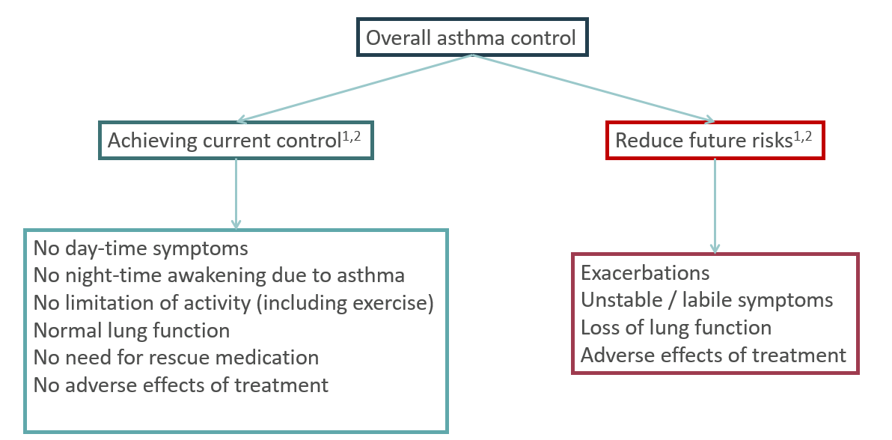
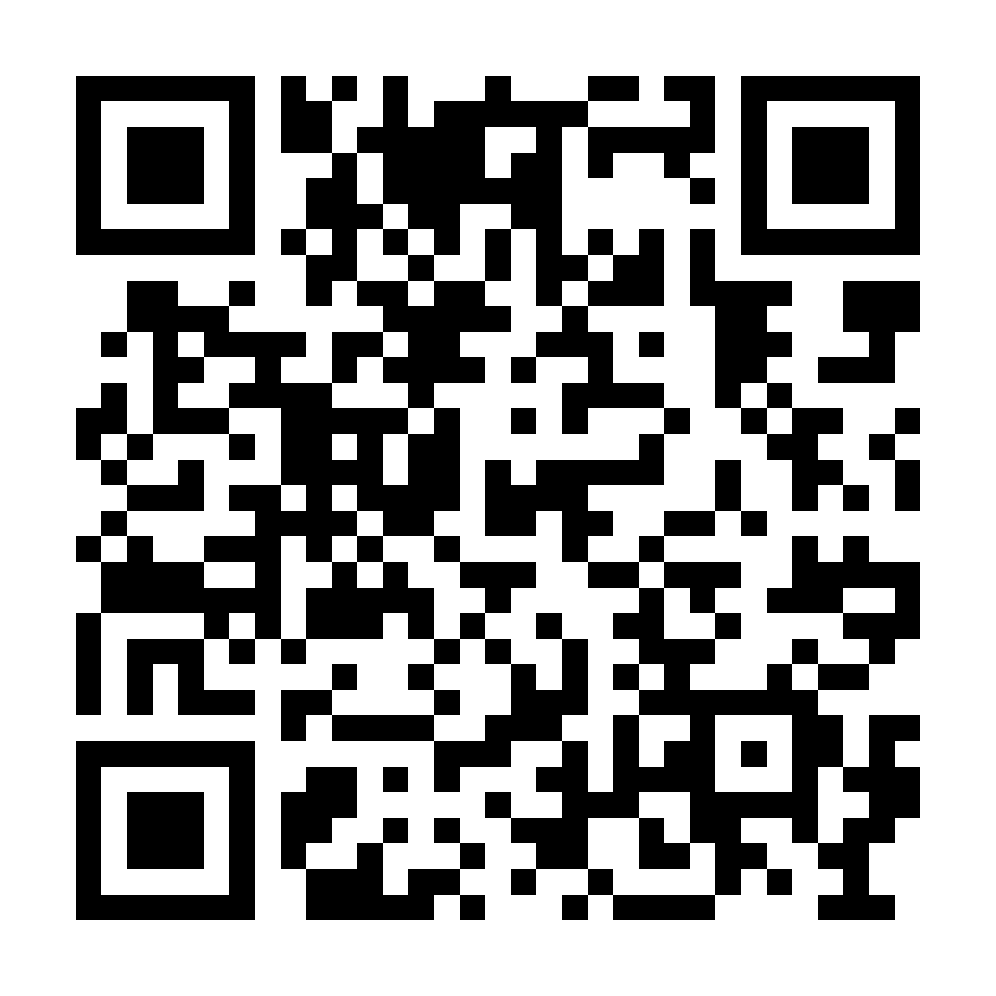
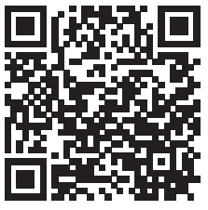
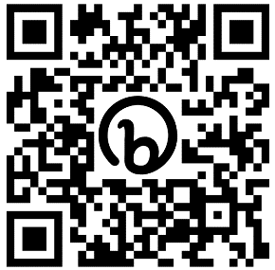
ICS/Formoterol is the preferred reliever in asthma
The aim of asthma management is to achieve asthma control.
- What is asthma control?
ICS/Formoterol is the preferred reliever in asthma. ICS/formoterol is effective as required to relieve symptoms without regular preventer therapy in mild asthma (anti inflammatory reliever therapy: AIR) or alongside regular maintenance doses of the same inhaler (maintenance and reliever therapy: MART) in moderate to severe asthma.
Instructions during an asthma attack:
In an asthma emergency I should:
Sit up, stay calm and loosen tight clothing
Take 1* puff of my AIR/MART inhaler
If needed, take 1* additional puff of my AIR/MART inhaler every 1 to 3 minutes (up to a maximum of 6* puffs)
If I don’t feel better, or feel worse at any point, call 999 for an ambulance.
If the ambulance has not arrived after 10 minutes and my symptoms are not improving, I should repeat step 3.
If am still still not improving, I should contact 999 again immediately.
*If using Symbicort pMDI 100/3, 2 puffs equate to 1 puff of the Turbohaler. Therefore use 2 puffs as needed, up to a maximum of 12 puffs.
ICS/Formoterol Reliever
Formoterol is a fast- and long-acting bronchodilator, providing rapid relief of bronchoconstriction
Using ICS/formoterol as a reliever ensures that symptomatic asthma patients receive an inhaled corticosteroid, even when adherence to preventer therapies is sub-optimal.
AIR is as effective at preventing asthma attacks as taking regular ICS with SABA reliever in mild asthma and is safer than using SABA alone
Do not routinely co-prescribe a SABA alongside an AIR/MART regimen. SABA co-prescription has potential to lead to confusion and continued SABA over-use.
Provide a dedicated Asthma Action Plan when prescribing AIR and MART
1. BTS/SIGN, Guideline for the Management of Asthma, July 2019.
2. Global Initiative for Asthma (GINA). Global Strategy for Asthma Management and Prevention, Updated 2022.
Excessive reliever use† indicates the need for asthma review. Always provide a personalised asthma action plan with guidance to patients about when to seek review by an asthma clinician.
Who/when to refer for a specialist opinion (aged $≥$12 years)
Principles of Good Asthma Care
Check that all principles are being followed when considering stepping up asthma treatment
Diagnostic uncertainty based on clinical judgement +/- primary care investigations
Unexpected / inconsistent clinical findings (e.g. stridor, monophonic wheeze, clubbing, cyanosis).
Suspected occupational asthma
Prominent systemic features (myalgia, fever, weight loss)
Patients uncontrolled on moderate dose MART plus LTRA/LAMA when T2 biomarkers low.
Patients uncontrolled on moderate dose MART with elevated T2 biomarkers (see 12+ guideline for age specific range).
Frequent exacerbations (requiring 2 or more oral corticosteroid courses per year despite optimal inhaled therapy).
Difficult asthma (e.g. suspected inducible laryngeal obstruction, refractory reflux etc.)
Inhaler technique should be taught and reviewed during every asthma consultation. Inhaler technique videos are available at: How to use your inhaler | Asthma UK
Adherence with preventer therapy is often low and should be assessed and addressed during every asthma consultation.
If prescribing a pMDI inhaler, an appropriate spacer should be prescribed and instructions about its use and maintenance provided.
All patients should be given a personalised asthma action plan which should be updated following any treatment change.
Patients using MART should not be co-prescribed a SABA inhaler (see above).
Appropriate life-style and self-management advice should be discussed during each asthma consultation (e.g. trigger avoidance smoking cessation, physical activity, weight management etc.)
Persistent use of ICS/formoterol for relief of symptoms 7 or more times a week should prompt review and step up of maintenance treatment considered.
Asthma diagnosis should be reconsidered and features of difficult asthma considered whenever step-up of treatment is considered.
For advice about when to refer children aged 5-11 years, see specific guideline (page 2)
Where can I find more asthma resources?
Implementation Resources
A+L UK
SENTINEL Plus Quality Improvement Framework
Greener Practice Toolkit
Add QR Code
HNY Asthma Guidelines FINAL Approved by IPMOC 20.09.23

