Slide 1
Oral Health Campaign
Background
Across England, and specifically within the Humber and North Yorkshire area, there are major problems for many people trying to access NHS Dental appointments due to national issues such as workforce retention and capacity, and insufficient funding.
NHS Humber and North Yorkshire Integrated Care Board (ICB) is working hard with our partners and national government to put in place a number of practical measures to help make it easier for people to see a dentist.
Good oral health remains essential for good general health. The ICB oral health campaign will give practical advice on how people can look after their teeth and what to do if they have a dental emergency.

Slide 2
Oral Health Campaign
Aim
The is a preventative campaign with the aim of improving the health of our population’s teeth to reduce toothache and ease the need for urgent or emergency dental work.
Objectives
Raise awareness of and provide good oral hygiene in children aged 0-7
Educate people to the benefits of good oral health and what they can do to improve
Communicate what to do when in need of urgent dental care
Target Audience
Parents and Carers of children aged 0-7 years of age
Teenagers / Young Adults 13 - 24

Slide 3
Oral Health Campaign
Key Messages:
Parents and carers (0-7 year olds)
Help them brush twice a day to keep decay away
No need to rinse after brushing
Start brushing as soon as the first tooth comes through
Teenagers / Young adults
Brush your teeth twice a day with fluoride toothpaste
Clean between your teeth every day
Cut down on sugary foods and drinks

Slide 4
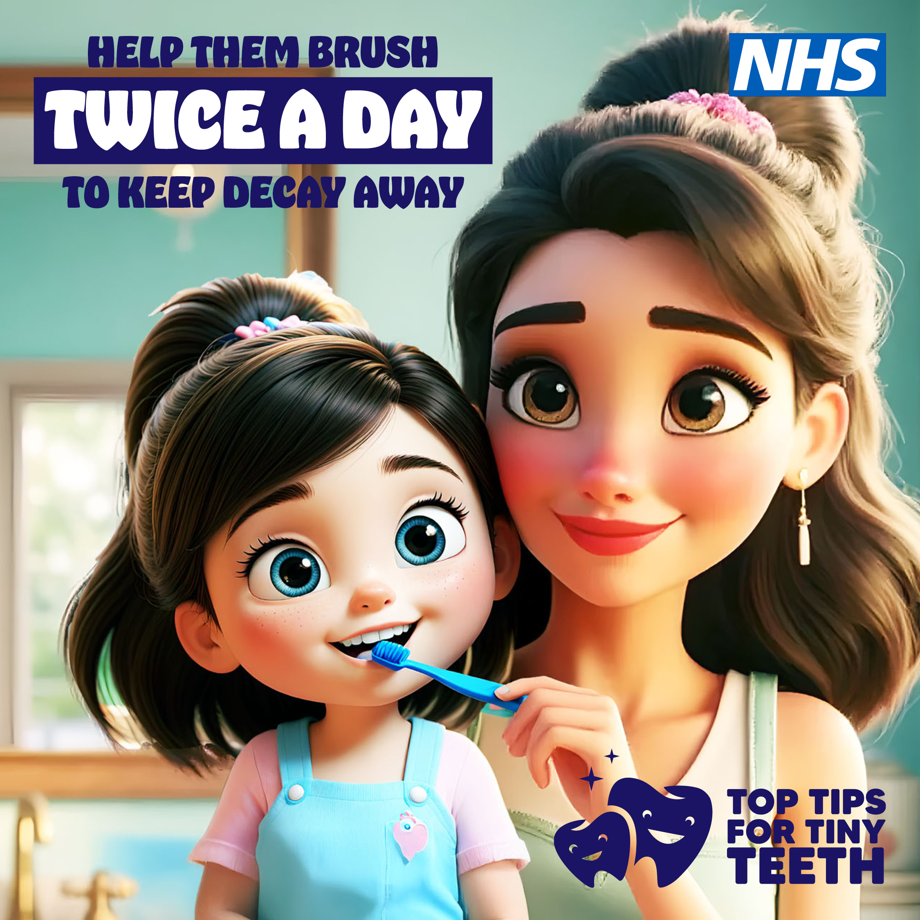
Top Tips for Tiny Teeth (Parents & Carers) Image and suggested social media copy
Brushing your child’s teeth twice a day from the moment their first tooth appears makes all the difference in keeping their teeth healthy for life.
Here’s why brushing twice a day for two minutes is vital:
Prevents cavities: Baby teeth matter – they help kids eat, speak and smile confidently.
Creates strong habits: Early brushing routines stick with them as they grow.
Keeps smiles bright: Healthy teeth mean happy kids!
Make brushing fun
Play their favourite song while they brush!
Use a fun timer to count down the two minutes.
Let them choose a toothbrush with their favourite character!
Help your child brush every morning and night – it’s the key to strong teeth and big, smiles.
Remember, healthy smiles start early.
And if you need urgent dental care contact NHS111 online, by phone or using the NHS App.
Visit www.letsgetbetter.co.uk/tinyteeth

Slide 5
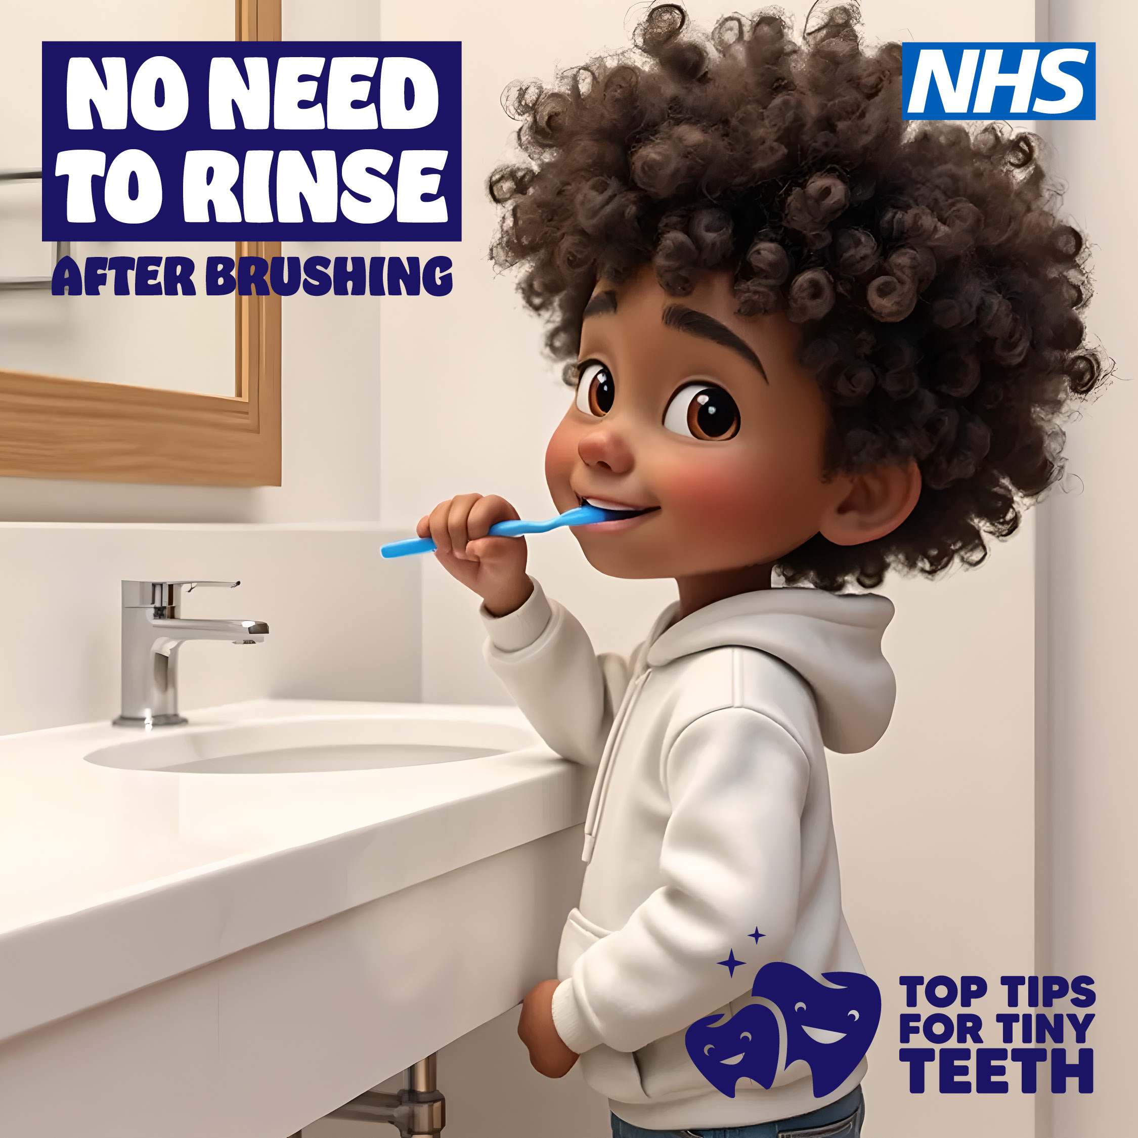
Top Tips for Tiny Teeth (Parents & Carers) Image and suggested social media copy
Skip the rinse for stronger smiles!
Did you know rinsing after brushing can wash away the fluoride that protects your child’s teeth.
Here’s why teaching your child to spit, not rinse is vital for their dental health:
Keeps fluoride working: Fluoride strengthens enamel and fights cavities—leaving it on their teeth longer gives better protection.
Creates strong habits: Early brushing routines stick with them as they grow.
Keeps smiles bright: Healthy teeth mean happy kids!
Encourage them to spit out the toothpaste after brushing but there’s no need to rinse with water!
Remember, healthy smiles start early.
And if you need urgent dental care contact NHS111 online, by phone or using the NHS App.
Visit www.letsgetbetter.co.uk/tinyteeth

Slide 6
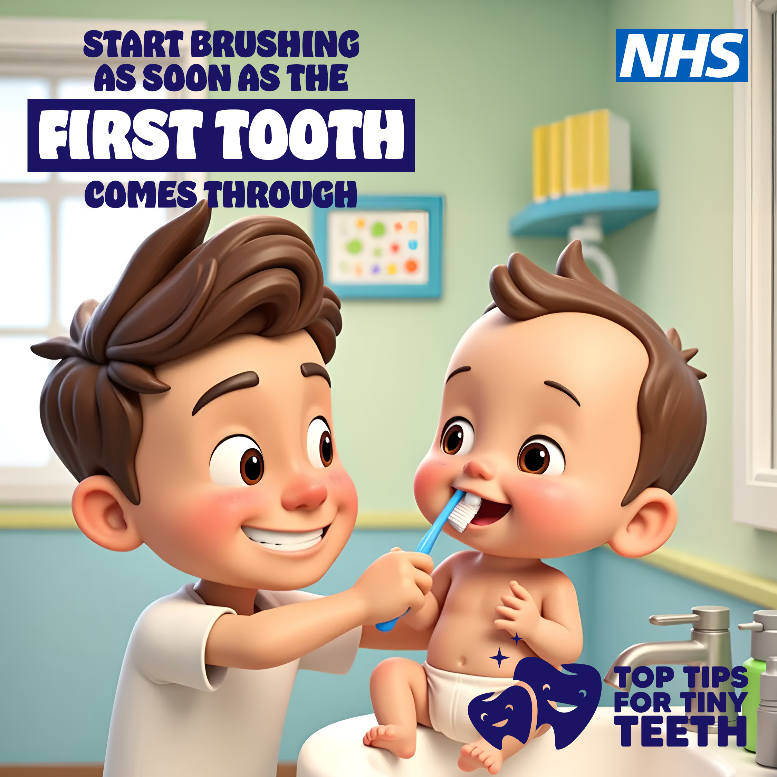
Your baby’s first tooth is more than just a cute milestone. It’s the start of their dental journey
Here’s why you should start brushing as soon as the first tooth appears.
Prevents decay: Even baby teeth are at risk of cavities!
Keeps them clean: Protects their tiny smiles.
Creates strong habits: Early brushing routines stick with them as they grow.
Keeps smiles bright: Healthy teeth mean happy kids!
Here’s how to start:
Use a soft baby toothbrush and a smear of fluoride toothpaste.
Gently brush twice a day for about two minutes. It’s never too early to start!
Remember, healthy smiles start early.
And if you need urgent dental care contact NHS111 online, by phone or using the NHS App.
Visit www.letsgetbetter.co.uk/tinyteeth

Slide 7
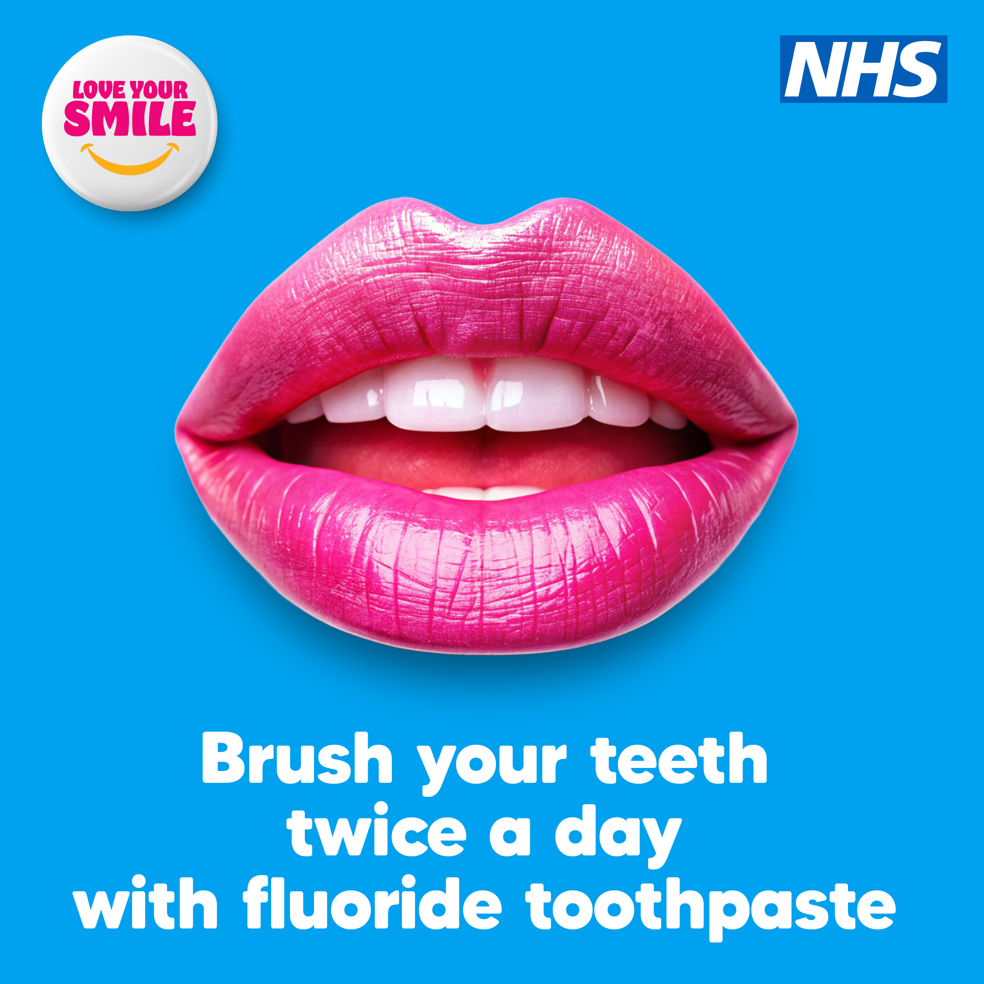
Love Your Smile (Teenagers and Young Adults) Image and suggested social media copy
Want a perfect smile? It all starts with brushing twice a day with fluoride toothpaste!
Fights cavities – Fluoride strengthens teeth & helps prevent decay. Fewer cavities = fewer trips to the dentist!
Freshens breath – Goodbye bad breath. Hello confidence!
Widens your smile – A healthy smile makes you feel amazing!
Brush twice a day for two minutes and love your smile!
And if you need urgent dental care contact NHS111 online, by phone or using the NHS App.
Visit www.letsgetbetter.co.uk/loveyoursmile

Slide 8
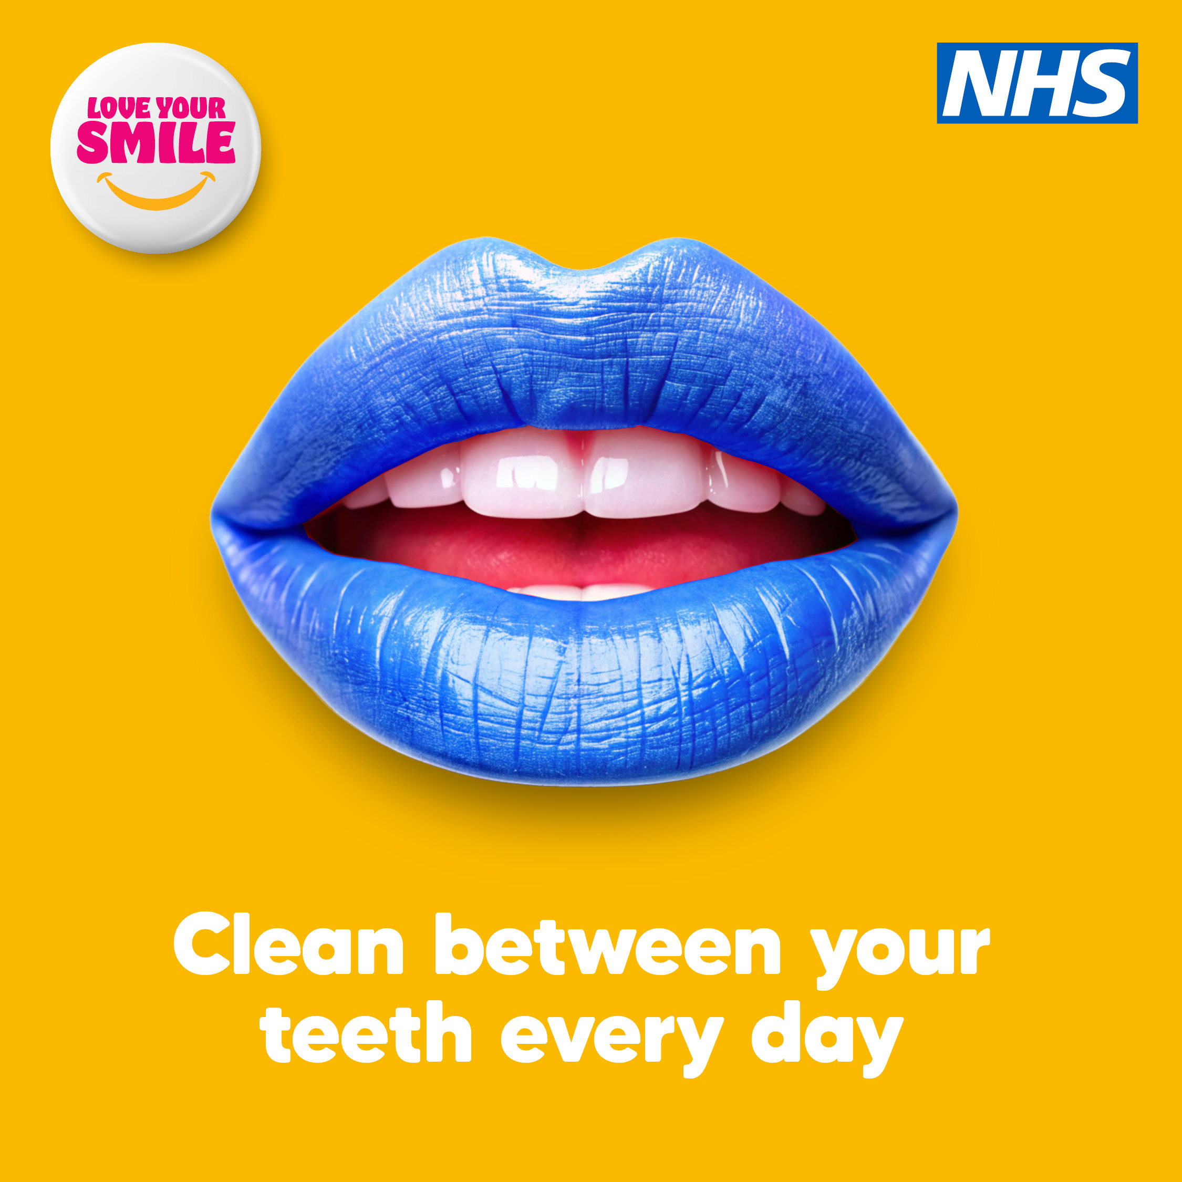
Love Your Smile (Teenagers and Young Adults) Image and suggested social media copy
For a perfect smile, brushing alone isn’t enough!
Floss or use interdental brushes every day to keep your smile fresh and healthy!
Removes plaque – cleans where your toothbrush can’t!
Protects your gums – helps prevent gum disease!
Freshens breath – goodbye bad breath. Hello confidence!
Floss like a boss for just a few minutes a day and love your smile.
And if you need urgent dental care contact NHS111 online, by phone or using the NHS App.
Visit www.letsgetbetter.co.uk/loveyoursmile

Slide 9
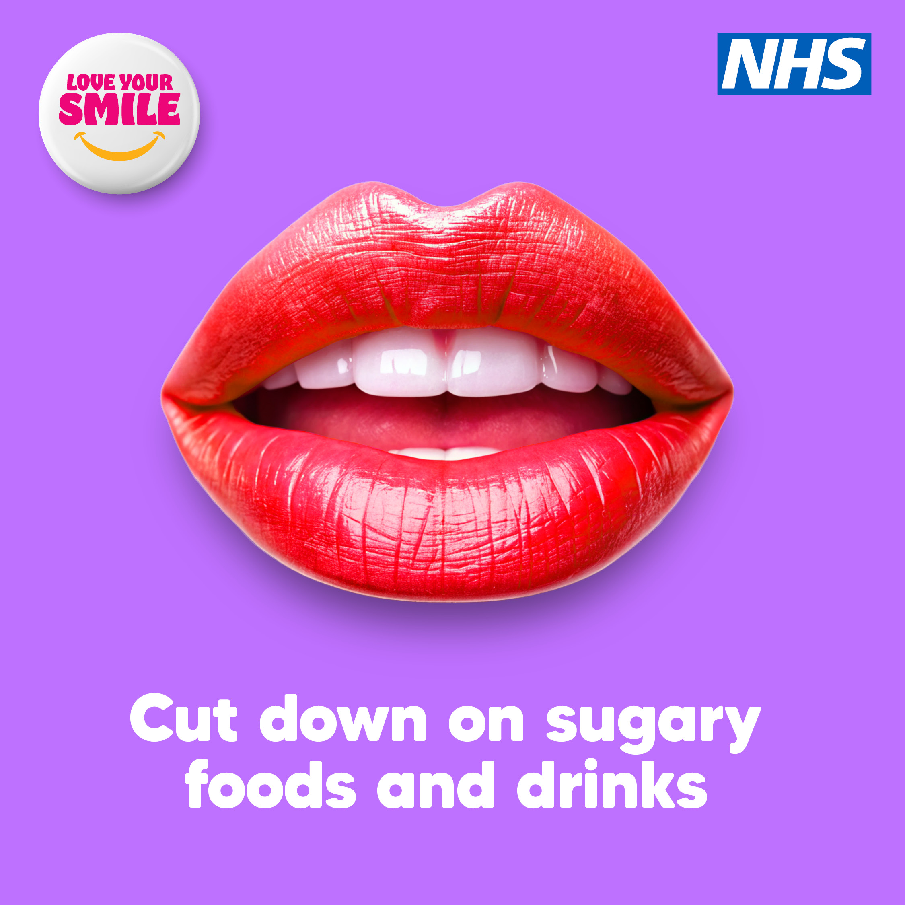
Love Your Smile (Teenagers and Young Adults) Image and suggested social media copy
Want a healthier, brighter smile? Here’s the secret: eat less sugar!
Fewer cavities – Sugar feeds bad bacteria, which cause cavities. Less sugar = fewer dentist visits!
Fresher breath – Too much sugar can lead to bad breath. Stay fresh!
Brighter smile – Less sugar means less staining and decay. Keep your smile glowing!
Swap sugary snacks for healthier options and love your smile.
And if you need urgent dental care contact NHS111 online, by phone or using the NHS App.
Visit www.letsgetbetter.co.uk/loveyoursmile

Slide 10
Website / Bulletin Copy
The Importance of Looking After Your Teeth
Your smile is one of the first things people notice, but it’s not just about appearances – taking care of your teeth is essential for your overall health and well-being. Healthy teeth enable you to eat, speak, and smile with confidence.
Top Tips for Tiny Teeth – Dental advice for children aged 0-7
We know that as parents and carers you all want the best for your children and there's one key habit that should not be overlooked during these formative years: the importance of establishing a regular tooth brushing routine.
Top Tips for Tiny Teeth offers you supportive advice and information on the best way to look after your children's teeth.
Visit www.letsgetbetter.co.uk/tinyteeth for more information.
Love Your Smile – Dental advice for teenagers and young children
When you're juggling school, work, social life, and everything else that comes with being a young adult, it's easy to overlook things like oral health.
However, if you take care of teeth now, you can set yourself up for a lifetime of good health!
Love Your Smile tells you all about why looking after your teeth should be a priority and how it can impact more than just your smile.
Visit www.letsgetbetter.co.uk/loveyoursmile for more information.

