Slide 1

Evaluating access to GP services in York for minoritised ethnic communities
Dr Vanessa Oo
-Health Equity Fellow, Humber and North Yorkshire ICB
-GP, Priory Medical Group

Slide 2
Overview
Why I embarked upon this project
Why it is important
What I did-methodology, mapping
What I found
Recommendations- for the practitioner, for the practice
Outcomes
Reflections

Slide 3
Aims
Evaluate access to GP services for minoritised ethnic communities (anyone not White British) in York
Build links between NHS and voluntary sector

Slide 4
Why does this matter?
VALUES
NEED
Notes:
VALUES
Why I embarked on this project:
It all started in the GP consultation room. I had consulted with a patient who did not speak English and I was shocked that I was told I could not access an interpreter if the patient was not a refugee or asylum seeker
My emotional reaction was that this felt unfair, that there was an implied value judgement and this represented a barrier to access to healthcare
This stayed with me as an area of concern
At the same time, I was feeling overwhelmed by requests from patients asking for their appointment to be expedited, or complaints that were emotional and lengthy to deal with.
I had an impression growing that in scarcity times, the NHS was becoming something where people who shouted loudest were getting better treatment, and this was not in keeping anymore with my values and the belief that the NHS is for all.
When the opportunity arose to take up this fellowship, I wanted to focus on addressing an imbalance between those who were shouting loud and those that were not able to shout at all. I was initially going to focus on language alone, but I discovered that interpreter services are coming to primary care in York and are in procurement as we speak. However, it highlighted to me that there might be a proportion of the population that is being overlooked and there may be other as yet undiscovered barriers because we are simply not asking the question.
NEED
Minoritised ethnic communities are included as a group of focus in a national approach to tackle health inequalities from NHS England and NHS improvement called the CORE20PLUS5. They are one of the groups that experience poorer health ‘access, experiences or outcomes’ (York Population Health Hub 2024).
Research has shown that there are health inequalities in minoritised ethnic groups but the reasons why are less clear. An article by the Kings Fund in 2023 showed that there are poorer health outcomes in particular communities- White Gypsy or Irish Traveller, Bangladeshi and Pakistani. South Asian people have higher rates of diabetes, although this is changing. Black people have higher incidence of hypertension and stroke, and lower rates of heart disease (Raleigh 2023).
The causes for these are put forward as a mixture of physiology, socioeconomic deprivation, lifestyle and diet. (Raleigh 2023).

Slide 5
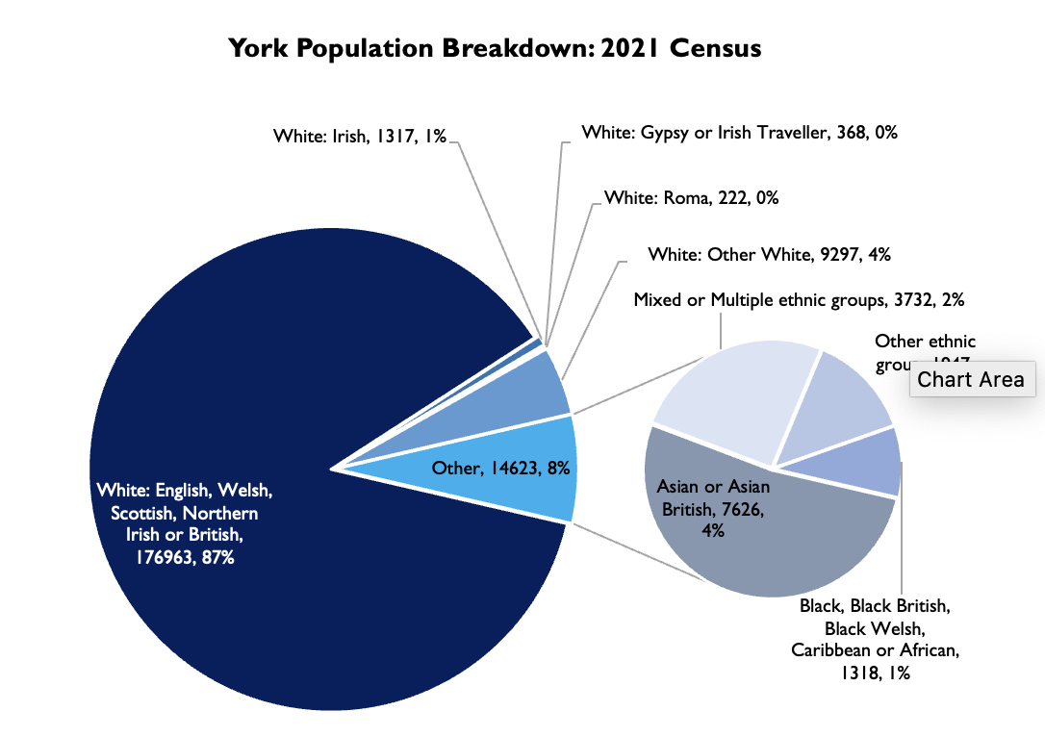
York Population Health Hub 2024 from Census 2021
Notes:
average England and Wales figures from 2021 Census says that non White British= 25% of the population (Office for National Statistics 2021)
Non White British in York= 13% of the population. This is a small proportion but still a significant number of people- over 25,000
What it means to be an ethnic minority in a predominantly white British area is different to somewhere ethnically dense, e.g. Leeds
A small proportion can indicate a small voice
IN CONTEXT OF YORK
Research by Inclusive Equal Rights UK 3.0 (IERUK) showed that racism in York was “casual, systemic, and structural” and there was York’s first anti racism summit in January 2024 (IERUK 2024). The 5 year aim is for York to be the first anti racist city in the North of England and the council is working in conjuction with IERUK to achieve this. Following the fatal stabbing of 3 girls in Southport in August 2024 there has been rioting in England some of which has been reported as anti immigration and racist. Now is as important a time as ever to take a stand and make people feel welcome. I strongly believe this should also apply to our NHS systems.

Slide 6
Why it is important to GP practices
“General practice organisations must ensure all patients have equitable access to care, and that decisions or policies do not unfairly disadvantage people or lead to an increase in inequalities” (NHS 2023)
GP access is what we can control
Higher efficiency

Slide 7
Methodology
Look at data- is there an access issue?
Identify local groups via York CVS and snowballing
Interview local group leaders/charity group workers (n=8)
Focus Groups (n=4, n=10)
Small scale supplementary surveys using interpreters where needed (n=69)
Notes:
For the surveys, I used interpreters who were at events where needed- this allowed people to be included who cannot speak English

Slide 8
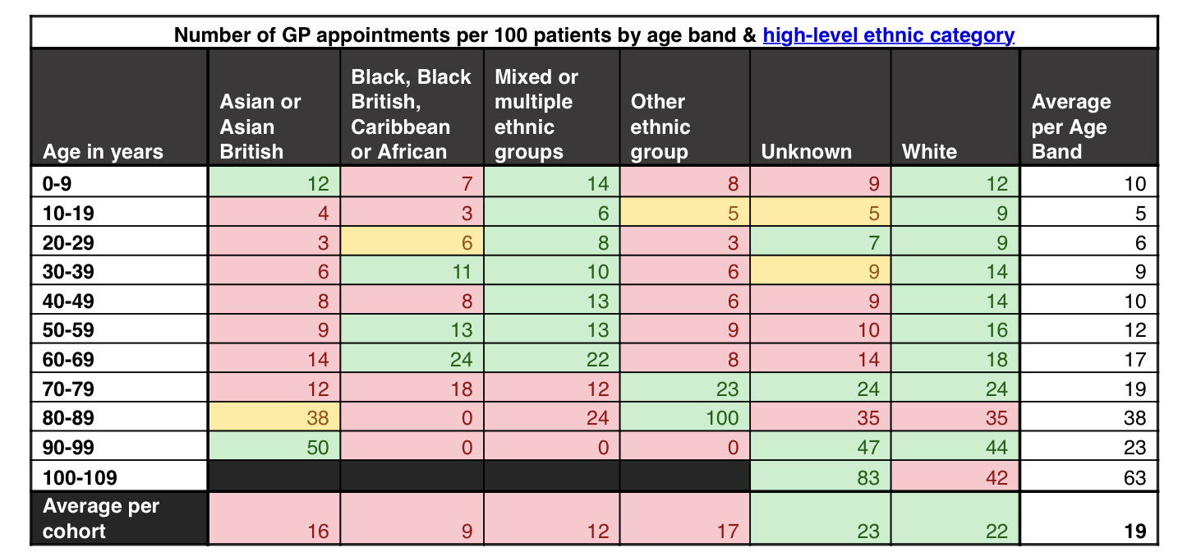
Notes:
This table was produced for me by York Population Health Hub. I asked them to extract the number of GP appointments across one month (June 2024), by ethnicity
This included all GP practices using System One across York.
On average in the White ethnic category there are more appointments on average.
‘White’ column includes all White ethnicities, not only White British
It must be interpreted with caution as there may be a healthy migrant effect, in which migrants tend to be younger, healthier and able to work so we cannot say truly from the table that the lower rates are due to access issues. i.e. there may be selection bias.

Slide 9


York Place*
Minoritised Ethnicities comparison – 08/11/2024
 |  |  |  |  |  | Whole Population |  |  |  | Minoritised Ethnicities*
Category | Disease | Local | QOF | Indicator | Target | Denominator | Numerator | Prevalence | Achievement | Denominator | Numerator | Prevalence | Achievement
CVMD | Atrial fibrillation | WPCVD1 | AF001 | AF diagnosed | 2.5% | 225412 | 5638 | 2.50% | 100.05% | 17843 | 26 | 0.15% | 5.83%
CVMD | Atrial fibrillation | WPCVD2 | AF008 | AF on DOAC | 90.0% | 4469 | 4167 | - | 93.24% | 17 | 13 | - | 76.47%
CVMD | Hypertension | WPCVD3 | HYP001 | HYP diagnosed | 26.2% | 193256 | 31636 | 16.37% | 62.48% | 14839 | 651 | 4.39% | 16.74%
CVMD | Hypertension | WPCVD4 | HYP008/9 | HYP & BP treated to target | 80.0% | 28858 | 21326 | - | 73.90% | 561 | 369 | - | 65.78%
CVMD | Cholesterol | WPCVD5 | N/A | QRISK done in last 5y | 75.0% | 89539 | 20280 | - | 22.65% | 3619 | 687 | - | 18.98%
CVMD | Cholesterol | WPCVD6 | N/A | QRISK score >20% & on statin | 45.0% | 13400 | 7938 | - | 59.24% | 122 | 80 | - | 65.57%
CVMD | CKD | WPCVD7 | CKD005 | CKD diagnosed | 6.1% | 193256 | 7655 | 3.96% | 64.94% | 14839 | 74 | 0.50% | 8.18%
CVMD | CKD | WPCVD8 | N/A | CKD stage 3-5, >=18yrs, & on SGLT2 | - | 7655 | 784 | - | 10.24% | 74 | 10 | - | 13.51%
DM | Diabetes | WPDM1 | DM033 | DM without frailty & BP <=140/90 | 78.0% | 8536 | 6279 | - | 73.56% | 341 | 247 | - | 72.43%
DM | Diabetes | WPDM2 | DM020/1 | DM without frailty & HbA1c <=58 or with frailty <=75 | 83.5% | 8634 | 6041 | - | 69.97% | 328 | 215 | - | 65.55%
DM | Diabetes | WPDM3 | DM022/23 | DM >=40yrs without frailty on statin | 90.0% | 7964 | 6654 | - | 83.55% | 252 | 187 | - | 74.21%
RESP | COPD | WPRESP1 | COPD010 | COPD review in last 1y with # of exacerbations & MRC | 90.0% | 3296 | 2444 | - | 74.15% | 8 | 3 | - | 37.50%
RESP | COPD | WPRESP2 | COPD014 | COPD & MRC >=3 referred to pulm rehab | 90.0% | 172 | 124 | - | 72.09% | 0 | 0 | - | 100.00%
RESP | Asthma | WPRESP3 | AST007 | AST review in last 1y with ACT & care plan etc | 70.0% | 12480 | 7765 | - | 62.22% | 250 | 150 | - | 60.00%
RESP | Asthma | WPRESP4 | AST008 | AST <19yrs & smoking status in last 1y | 80.0% | 1521 | 1153 | - | 75.81% | 19 | 15 | - | 78.95%
*Excluding EMIS practices.
*Including all patients with an ethnicity recording other than White British or Unknown.
Notes:
This shows QOF data across York Place for System One practices.
It was provided on request by York Population Health Hub.
It shows a discrepancy between whole population figures and minoritised ethnicities for diagnosis and treatment of conditions such as atrial fibrillation and hypertension. There is also a discrepancy for those with already diagnosed conditions on treatment although it is not as large. This difference is not present for diabetes.

Slide 10
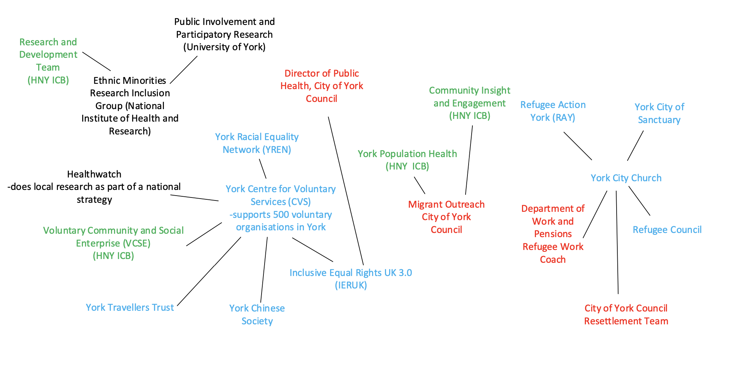
Groups in York involved in minoritised ethnic communities
Notes:
This represents groups who I had contact with when engaging with minoritised ethnic communities
It shows the breadth of different organisations involved who have significant knowledge and relationships
It is by no means a comprehensive diagram of all the groups available and I was unable to engage with all the organisations due to time/ modes of communication available/ people’s availability

Slide 11
Groups involved
Groups focussing on migrants
City of York Council Migrant Outreach
Groups focussing on refugees
York City of Sanctuary
York City Church
Department of Work and Pensions
Refugee Action York
Refugee Council
Interest Groups
YREN (York Racial Equality Network)
IERUK (Inclusive and Equal Rights UK)
Specific groups based on ethnicity
York Travellers Trust
York Chinese Society

Slide 12
RESULTS
2 FOCUS GROUPS
York Chinese Society (n=4)
York Migrant Outreach Group (n=10)
8 INTERVIEWS WITH WORKERS WHO ARE CLOSE TO THE COMMUNITY
69 SURVEYS
Notes:
Surveys distributed here with assistance of interpreters where needed
City of York Council Migrant Outreach
City of York Council
Refugee Action York
York City Church
York Chinese Association
Ethnic Minority Research Inclusion Group (NIHR)
Assisted by interpreters who were present where surveys given out eg at York City Church, RAY meeting, Migrant Outreach

Slide 13
MAIN FINDINGS
LANGUAGE BARRIER
HEALTHCARE NAVIGATION
TRAUMA
TRUST

Slide 14
69 surveys
Notes:
Ethnicity
Asian or Asian British
Pakistani 2
Chinese 18
Other Asian 9 Afghani 7
Black, Black British, Caribbean or African
African 2
Mixed or Multiple ethnicities
2
White
English, Welsh, Scottish, Northern Irish 1
Any other White background 22 (Spanish 1 Turkish 5 Polish 1 Ukraine 11 Romanian 1 European 1)
Other ethnic group
Arab 8
Any other ethnic group-Iraq 1, Kurdish 2
Did not answer 2
AGE
Age 65 and over 9
55-64 10
45-54 17
35-44 15
25-34 13
18-24 4
Did not answer 1
GENDER
Female 45
Male 23
Did not answer 1

Slide 15
Findings- 69 survey results
18 people cited language as a barrier to access to GP services
People felt welcome ‘always’ and ‘mostly’
People felt satisfied ‘always’, ‘mostly’, ’sometimes’
Other barriers were busy phone lines and waiting times
11 people did not know how to make an appointment
Very variable results in knowing where to seek help for a medical problem

Slide 16
I feel confident about where to seek help for a medical problem
Very confident= 29
Somewhat confident= 17
Not very confident= 9
Not at all confident= 14
Notes:
Question 7 of survey- If I have a medical problem, I will first get information from:
(respondants could put multiple options)
GP 31
internet 18
family 16
friends 8
social media 3
Other-call 999

Slide 17
DWP
We need York specific healthcare navigation
York Traveller’s Trust
YREN
People are going to Ukraine to get healthcare
York City of Sanctuary
Refugee Council
trauma of insecurity
Refugee Action York
people come to us first for help
CYC Migrant Outreach
York Chinese Association
complex referrals are confusing
the trauma is hidden
Notes:
These are findings from interviews with workers who work closely with the community

Slide 18
FOCUS GROUPS-COMMUNICATION
SHE HUNG UP THE PHONE AND SAID, “DO I HAVE CANCER?”
IT TAKES ME 45 MINUTES TO COMPLETE THE ONLINE FORM
I HAD TO WAKE A FRIEND SO I COULD TAKE MY CHILD TO A AND E
INSIGHTS ON USE OF INTERPRETERS
Notes:
The first quote is from a patient who is bilingual who is often called upon to interpret for friends. She had happened to be there when a friend received a call from the GP telling her about a benign (non cancerous) cyst. She then turned to her friend and asked, “Do I have cancer?” showing that she had not understood the call at all. Telephone consultations can be a poor way to communicate- there are no visual clues and extra care must be taken to check a patient has understood.
Second quote- this is the reality of making an appointment for some of our patients, but it is worse if there is a language barrier.
Third quote- this is a stressful situation for anyone but clearly a barrier to accessing help. Not knowing what is available can be as impactful as what is actually available.
Interpreter availability will not be a panacea. Participants reported interpreters speaking the wrong dialect, being rude, not interpreting correctly. In some places they had been asked not to have a friend interpret but half of people in the focus group would rather have a friend. They had an addition role as an extra pair of ears and an advocate.

Slide 19
Recommendations
For clinicians
For GP practices

Slide 20
CLINICIAN TIPS- communication
USE SMS/PRINT NOTES- consider finishing your consult with an sms/ printing out consultation notes- people can use translation tools/ show relatives after if they haven’t fully understood. Add a name for sms as multiple people may use the same phone
ROUTINELY DOCUMENT COMMUNICATION PREFERENCES- add note to homescreen if you find any language issues- more efficient for next time! Language preferences/ preferred mode of contact/ consent to preferred person to contact or assist. Some refugees may have support workers
SIMPLE JARGON FREE LANGUAGE, SHORT SENTENCES- helpful for basic English speakers, and when using interpreters as they don’t necessarily have medical vocab training
LOW THRESHOLD FOR F2F – allows non verbal cues as well as interpreting assistance
Notes:
Bear in mind this barrier still exists when asking patients to chase referrals etc, consider having a lower threshold to help out/ be realistic

Slide 21
CLINICIANS
Awareness of trauma
  Instability
  discrimination
Notes:
-Asylum seekers and refugees can continue to experience instability even after they have reached the UK. Having an awareness of this when considering the stress bucket, of what people are experiencing in the background as well as what they are presenting with
-York Travellers Trust gave a talk at PLT in 2024 explaining that Gypsy and Traveller groups have been continually discriminated against through history. They are also White which makes their ethnicity not obvious and this can lead to a feeling of needing to ‘come out’ to explain their ethnicity
-Some people may also be experiencing discrimination in different settings. This has not come out in my particular survey- perhaps from how I have sampled the patients- often handing out the surveys face to face. IERUK will share their experiences of racism in healthcare in the city in the PLT session we are presenting together 12/3/25.

Slide 22
WHAT CAN GP PRACTICES DO?
CONSIDER THE LANGUAGE BARRIER AT A SYSTEM LEVEL
  Direct f2f appointments bookable with interpreter available
  Routinely record communication needs on homescreen
    LANGUAGES SPOKEN
    LANGUAGE SUPPORT NEEDED
    COMMUNICATION PREFERENCES
    PEOPLE PATIENTS CONSENT TO USING FOR SUPPORT
  Newly registered- any existing referrals? Welcome pack with healthcare navigation- NHS/ practice specific
BECOME A DOCTORS OF THE WORLD SAFE SURGERY
DATA COLLECTION
Notes:
Doctors of the World is a London based charity and provides accreditation to become a ‘Safe Surgery’- this includes an outward commitment that people can register without documents, and there will be interpreters available. If the practice meets the criteria, it is a way of outwardly signalling that people are welcome and people in the organization have thought about them. It can make an ideal QIP for GP registrars.
Data collection- we have quite a lot of ethnicity data but it is quite complicated to use in System one. You can search patients by ‘ethnicity’ of which there are many categories, and ‘ethnicity category’. The ethnicity category corresponds to census data, but the categories change every 10 years, so they are not always comparable. Some labels also seemed inconsistent. This is to be aware of when wanting to use the data. My suggestion for anyone attempting this in the future would be to do it with a particular question in mind.

Slide 23
OUTCOMES:
York wide
Healthcare navigation- shared York based healthcare navigation information with CYC Migrant Outreach and Community Engagement team at ICB
Shared findings with GP practices in York- presenting 2 x 1 hour workshops at PLT (GP teaching afternoon for all York GP practices) 12th March 2025 in conjuction with IERUK, an anti-racism charity in York, and Dr Peter Roderick, Director of Public Health for York
Encouraged people to commit to 3 actions to address issues faced by ethnic minorities at their GP- group exercise at PLT
I have fedback findings and outcomes to community groups involved
At Priory Medical Group
I have fedback findings to Priory Medical Group- as a result people with language barrier now included in groups which can make direct routine face to face appointments
Emailed all clinicians with tips on communicating when there is a language barrier
Invited groups I met to Patient Participation Group at Priory Medical Group
Shared links to community groups with social prescribers at Priory Medical Group
Notes:
HYN ICB “We Need to Talk” campaign, including videos and social media
I have passed on my current work to ICB Community Engagement Officer on mapping/ health care navigation specific to York so that the background work I have done can be used for her engagement work and this was presented it along with her findings to her boss at ICB. There will also be a repository formed by the ICB currently in its infancy ’What We Know”

Slide 24
Context of this work
Interpreters are coming to HNY imminently!
NHS England Community Languages Deliberative Event Dec 24
GP access survey by Healthwatch York released in September 2024
Other similar work showing similar findings in nearby areas, e.g North Yorkshire Council
Working with Migrant Communities training end of 2024/early 2025 HNY https://workingwithmigrantcommunities.sites.sheffield.ac.uk
Notes:
Interpreters are coming to HNY imminently! Circa April 2025- undergoing procurement.
More research being done into use of interpreters and translators at higher NHS England level
Other similar work showing similar findings, e.g North Yorkshire Council
North Yorkshire Council –Increasing the uptake of vaccinations and supporting mental health in undeserved populations- Eastern European, GKT communities- survey of 53 people- Poland, Romania, Ukraine, how healthcare works/mixed on making appointments/people going back to home countries to seek medical assistance
Community Engagement Officer from NY ICB - Northallerton work 2022 which led to using Doctors of the World materials for healthcare navigation
Working with Migrant Communities workingwithmigrantcommunities.sites.sheffield.ac.uk A series of education provided at end of 2024/early 2025, a project made in conjunction with charities and third sector who work with the communities to develop an education programme. Everyday Bordering in the UK. There is an excellent online resource for training material.
GP access survey by Healthwatch released in September 2024. Exploring access to GP services in York, Healthwatch, September 2024
This included 61 responses from people that were non white British, and 1116 responses that were white British. This is 5% of the whole.
Language barrier, and being asked to translate was cited in only one of the survey responses. Otherwise the issues seemed fairly similar to the general population which was about difficulty in making the appointment/ appointment wait times/continuity of care but general satisfaction with care from GP when received. Some cited online forms as difficult to use.

Slide 25
REFLECTIONS
Healthcare navigation is needed for all, but particularly for this group-language, social networks, healthcare understanding
If we do not actively seek to include people we may miss chunks of the whole picture
Working can be siloed
Working with other groups takes dedicated time from both parties
Systems can reflect an organisation’s values
Healthcare navigation is available but patchy, how can we make this routine and rolling?

Slide 26
References
Njie H 2024, https://www.ieruk.org.uk accessed on 21/2/25
NHS 2023, Health Equalities and Digital Inclusion, accessed at https://www.england.nhs.uk/long-read/health-equalities-and-digital-inclusion on 21/2/25
Office for National Statistics (ONS), Census 2021
Raleigh V 2023, ‘The Health of People from Ethnic Minority Groups in England’, The Kings Fund, accessed at https://www.kingsfund.org.uk/insight-and-analysis/long-reads/health-people-ethnic-minority-groups-England on 29/4/24
York Population Health Hub 2024, ‘Health Inequalities in York, Core20PLUS5 profile for adults’, City of York Council

